Slide 1
HR Attrition Analysis & Retention Strategy case study
Insights & Actionable Recommendations
Prepared by : Ahmed Yassien Hussien
Role : Data Analyst/ Business Analyst

Slide 2
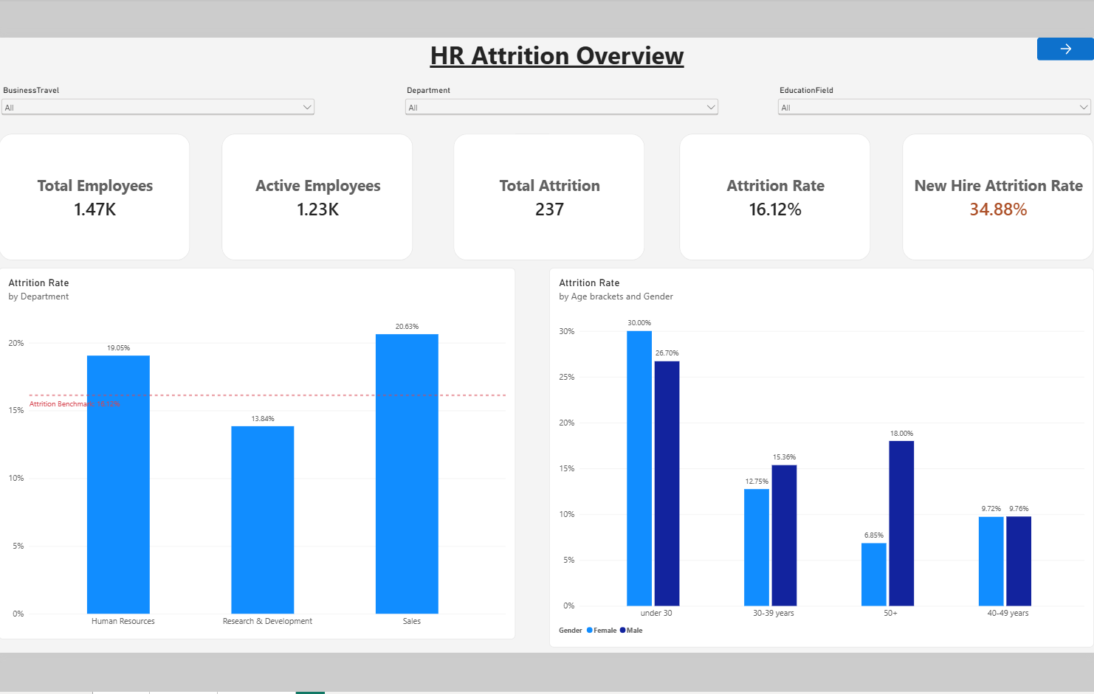
Attrition Overview & Key Metrics
Total Employees : 1,470
Active Employees : 1,233
Total Attrition : 237 employees
Attrition Rate : 16.12%
New Hire Attrition : 34.88%
Main Insight : While the overall Attrition rate is at 16.12% Early-tenure employees with one year or less at the company have an attrition rate of 34.88%, highlighting a potential onboarding and early-retention problems and it shows especially in the younger demographic of employees

Slide 3
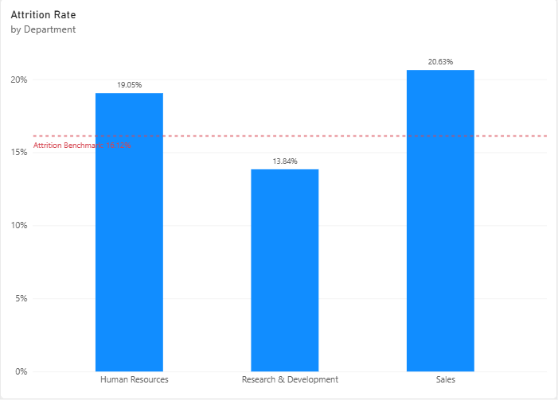
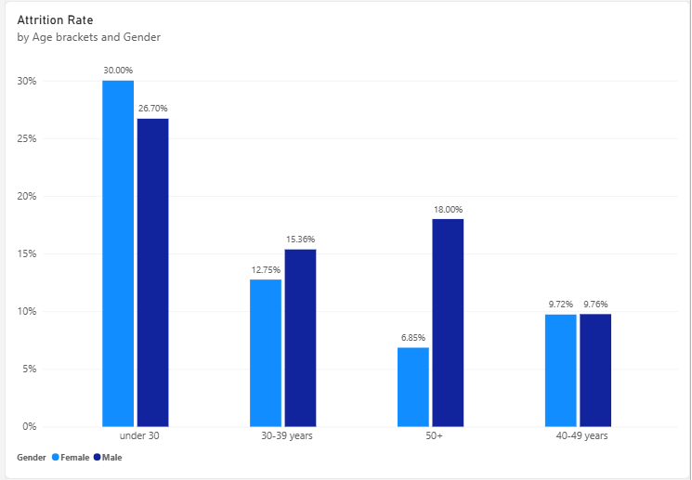
Where is attrition concentrated ?
Departments :
  Sales Department : 20.63% ( the highest ).
  Hr Department : 19.05% (close second).
Age Demographic : the most Attritions comes from the under 30 age demographic.
Main Insight : Sales has the highest attrition rate of all departments (20.63%), While HR presents high risk being 19.05% attrition rate despite being smaller departments with less employees which impacts the company’s onboarding and retention.

Slide 4
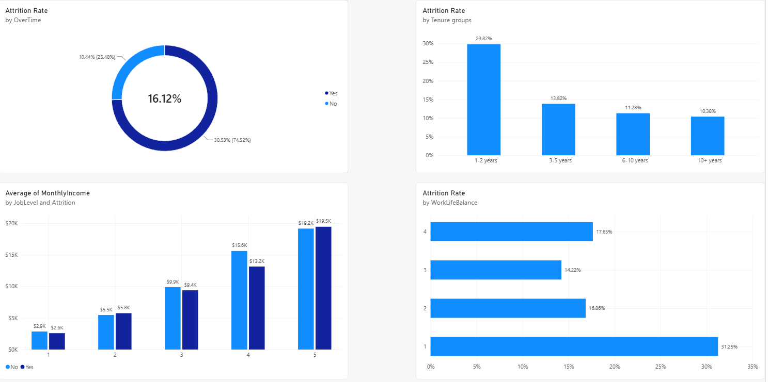
Factors Associated with Employee Attrition
Heavy overtime pressure: Employees who work overtime have 3 times more attrition rate (30.53%) than those who don’t (10.44%)
Work-Life balance: Employees who have low work-life balance have the highest attrition rate (31.25%)
Early Tenure: Employees with two years or less at the company have an attrition rate of 29.82%, indicating a potential retention challenge during the early employment stage
Compensation gaps : Employees who left had a lower average monthly income than employees who stayed (2,9k vs. 2,6k), suggesting an area for further compensation analysis
Main insight : Attrition is associated with overtime, work-life balance, and compensation differences. These patterns can help HR identify areas for further investigation and targeted retention initiatives.

Slide 5
Strategic Recommendations & Action Plan
Enhance onboarding and early Engagement
  Implement a periodic follow-up program for new employees.
  Implement the “Buddy System” to support the integration of new employees.
Optimize workload and overtime management
  Setting a limit to overtime hours to relieve work-related stress.
  Better distribution of workload and provide more flexibility to improve work-life balance.
Compensation alignment and career progression
  Analyze compensation differences by job level and job role.
  Establishing a clear path for promotion and development especially for under 30 group.
More support for sales and HR departments
  Investigate retention challenges in Sales and Human Resources.
  Develop targeted action plans based on department size, employee feedback, and attrition patterns.
Expected impact : Implementing these strategies will directly reduce the new hire attrition rate , also it will relieve work stress which caused people to burnout and leave ,Make the company a good place to stay and develop your career rather than to be a simple stop before leaving in less than a year and protect high-risk departments (sales, HR).

